Slide 1
SNAKE GAME AI

Slide 2
REINFORCEMENT LEARNING
Reinforcement Learning (RL) is an area of machine learning concerned with how software agents ought to take actions in an environment in order to maximize the notion of cumulative reward.
Or, RL is teaching a software agent how to behave in an environment by telling it how good its doing.

Slide 3
DEEP Q LEARNING
This approach extends reinforcement learning by using a deep neural network to predict the actions.

Slide 4
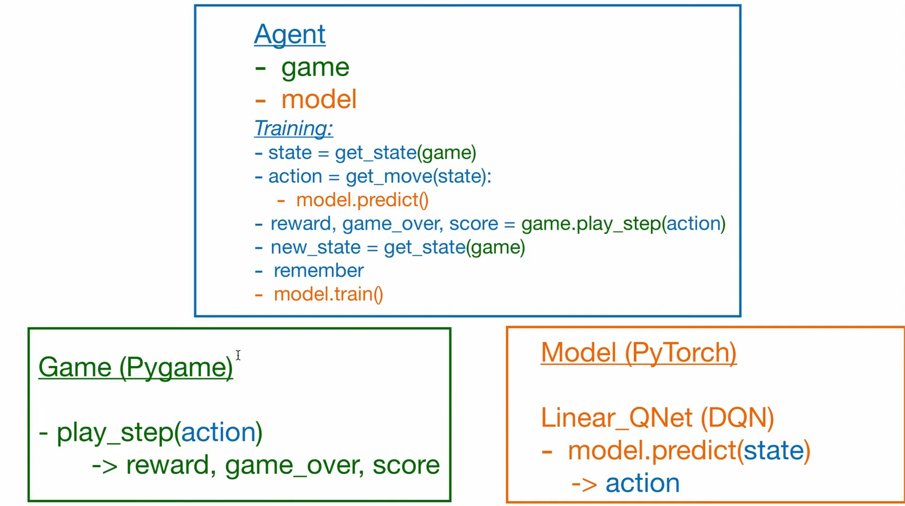

Slide 5
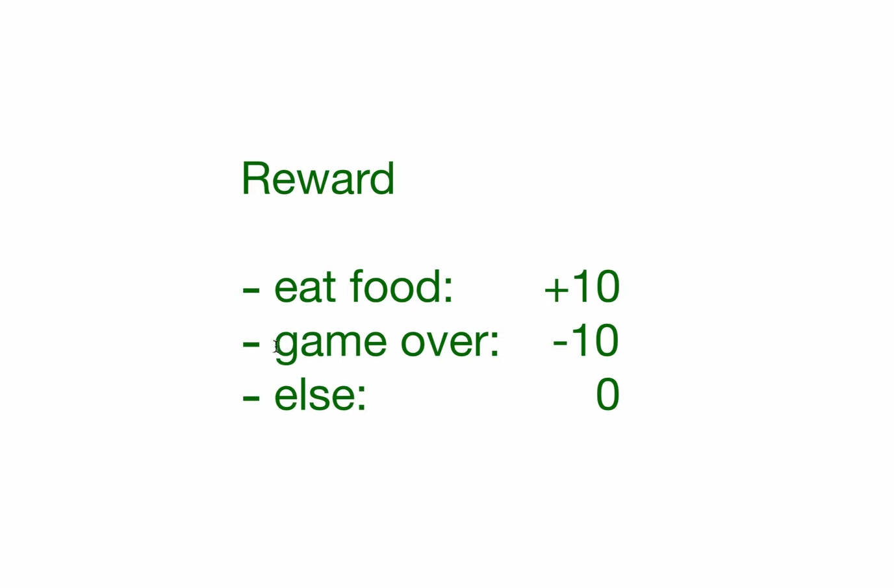

Slide 6
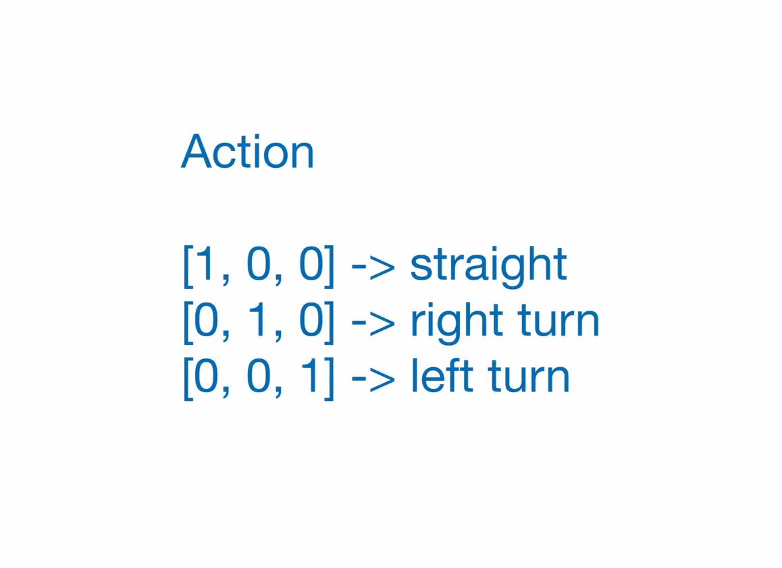

Slide 7
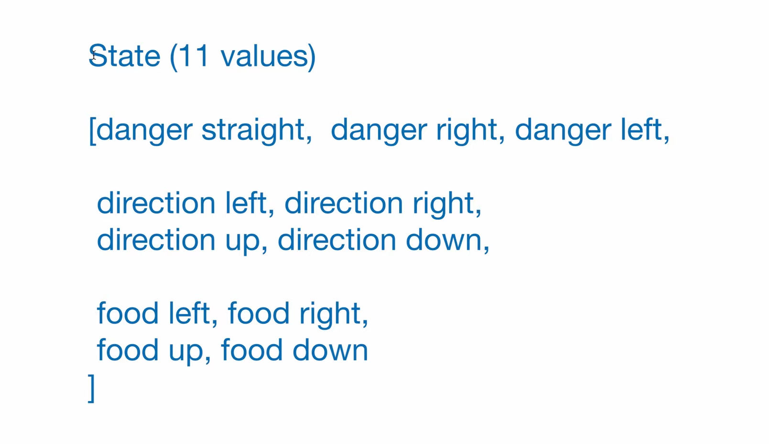

Slide 8
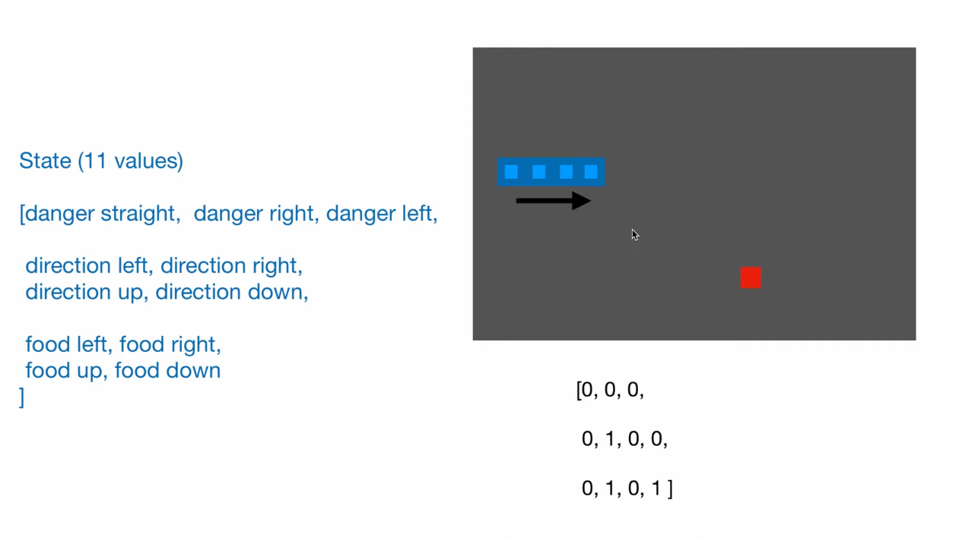

Slide 9
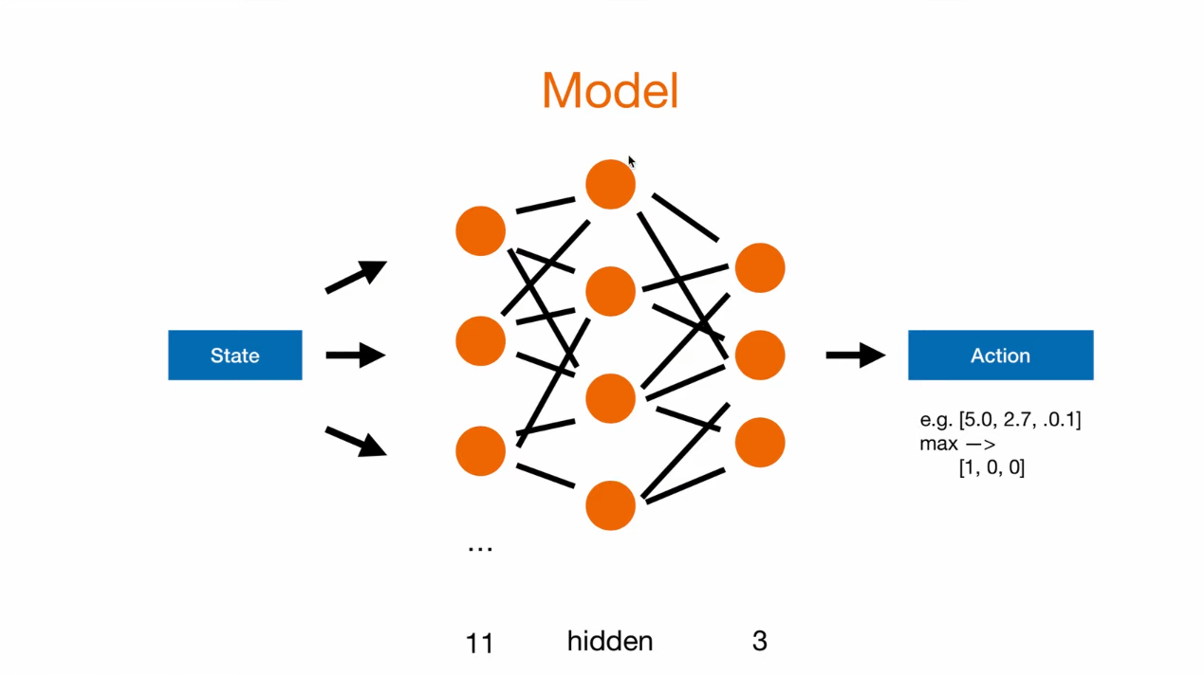

Slide 10
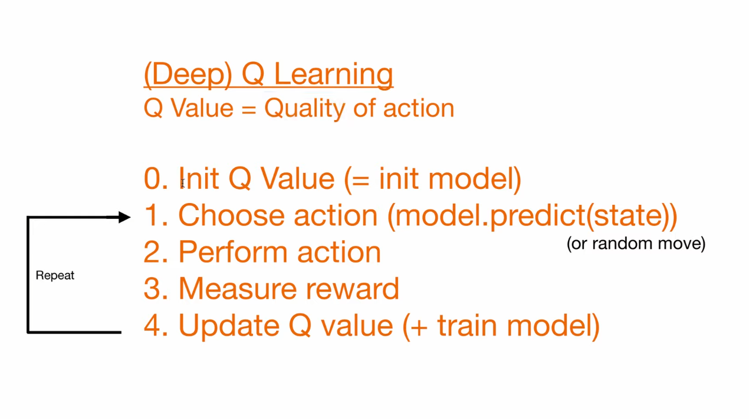

Slide 11
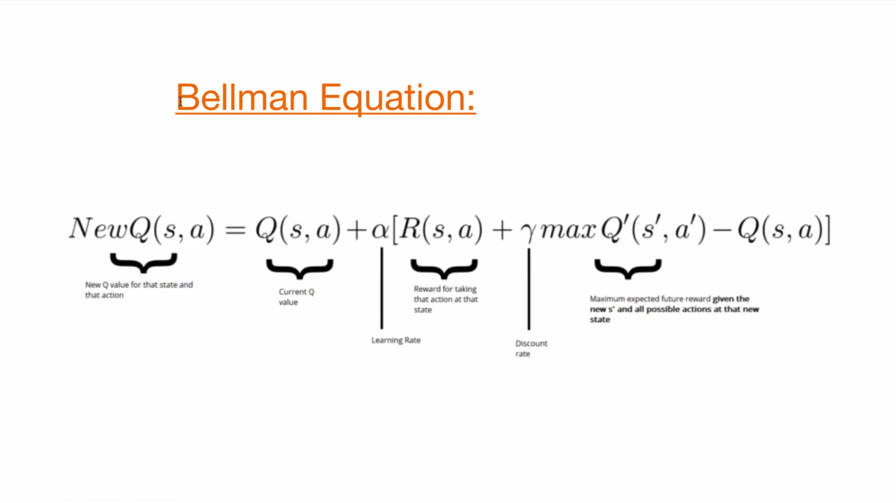

Slide 12
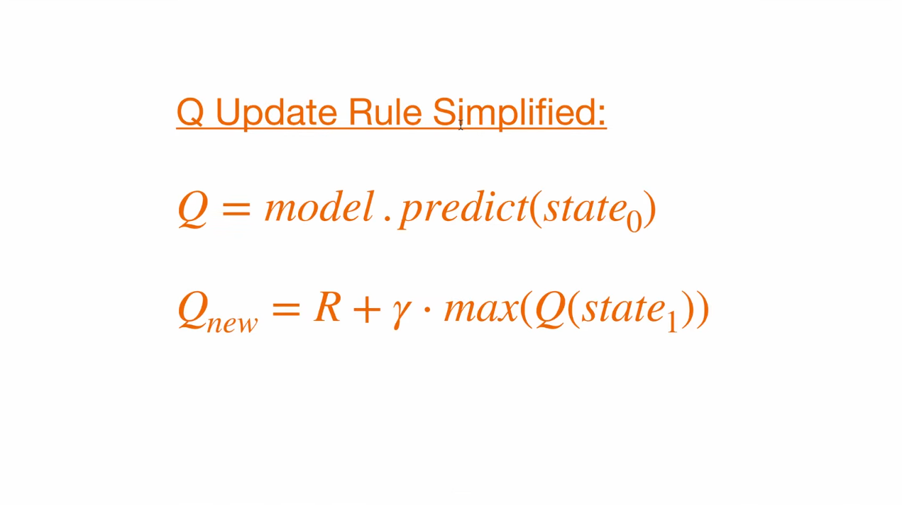

Slide 13
